Slide 1
Impact of climate change on local ecosystems
Paco, Soseki, Nucha, Ruksana, Riva, Sammy
(Group 14)
Notes:
Hello everyone. Today, we’ll be giving a presentation on the impact of climate change on local ecosystems. On my team we have [read the names aloud].

Slide 2
Learning Objectives
Unit 1 (Environment and Overview of Climate Change):
Identify four greenhouse gasses and explain why there are elevated levels in the atmosphere
Identify human sources of greenhouse gases
Notes:
First I will list out the learning objectives that we will discuss in this presentation.

Slide 3
Learning Objectives
Unit 2 (Cells and Life):
Explain how extinction rates today compare with those in the past.
Give examples of how different environments give rise to differences in the structure and function of organ systems of plants and animals.
Notes:
First I will list out the learning objectives that we will discuss in this presentation.

Slide 4
Learning Objectives
Unit 3 (Organism and Ecosystem Health)
Describe population responses to climate change
Discuss local (within British Columbia) consequences of the heat dome of 2021 to terrestrial and marine ecosystems
Notes:
[read out the stuff on the slide]

Slide 5
Unit 1
Identify four greenhouse gasses and explain why there are elevated levels in the atmosphere
Identify human sources of greenhouse gases
Notes:
[read out the stuff on the slide]

Slide 6
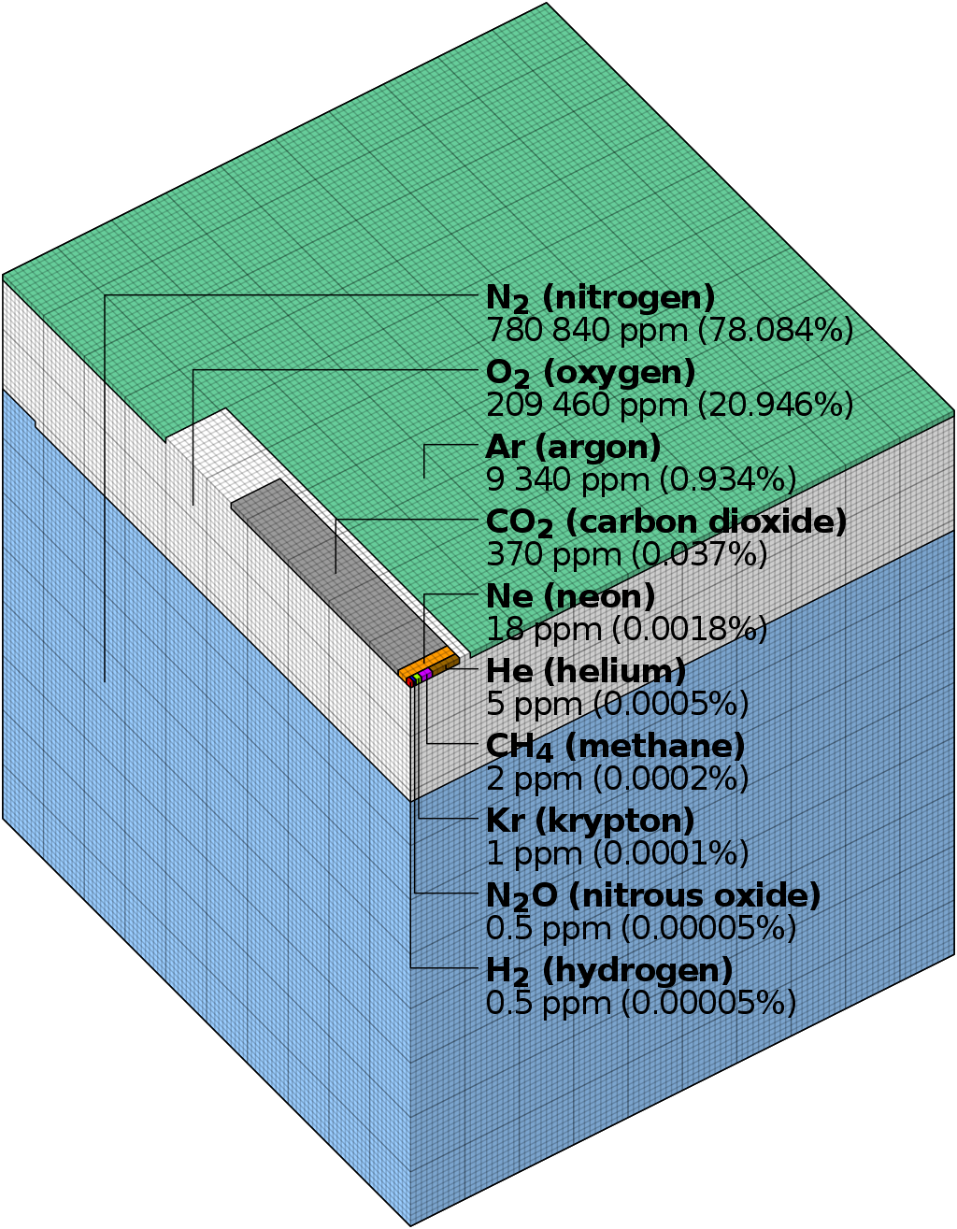
Greenhouse gasses in the atmosphere
(cmglee, 2011)
CO₂
H₂O
CH₄
N₂0
Data on right based on (NASA, 2008)
H₂O (water vapor) omitted from diagram due to high variability, from 0-3 %
Notes:
The current atmosphere is comprised of many gasses, as you can see in the diagram on the right. These gasses include nitrogen, oxygen, argon, carbon dioxide, neon, helium, methan, krypton, nitrous oxide, and hydrogen. Some of these gasses are greenhouse gasses, namely carbon dioxide at 370ppm, methane at 2ppm, nitrous oxide at 5ppm, and water vapor. Water vapor is omitted from the diagram as air samples typically use dry air as water vapor in air varies significantly between time and location. However, typically, water vapor is at 1% and can vary from 0-3% of the air.
As you can see, greenhouse gasses actually make up a very small part of our atmosphere, yet they have significant effects on the warming of the earth. In addition, some of these greenhouse gasses actually have different warming potentials. For example, nitrous oxide is 310x more potent than carbon dioxide. Methane has 21x the effect. While water has the strongest greenhouse effect, water vapor is removed by precipitation relatively quickly and is mostly dependent on air temperature rather than any indirect human effect.
https://en.wikipedia.org/wiki/Atmospheric_chemistry#/media/File:Atmospheric_composition_Langley.svg
https://www.nasa.gov/centers/langley/pdf/245893main_MeteorologyTeacherRes-Ch2.r4.pdf

Slide 7
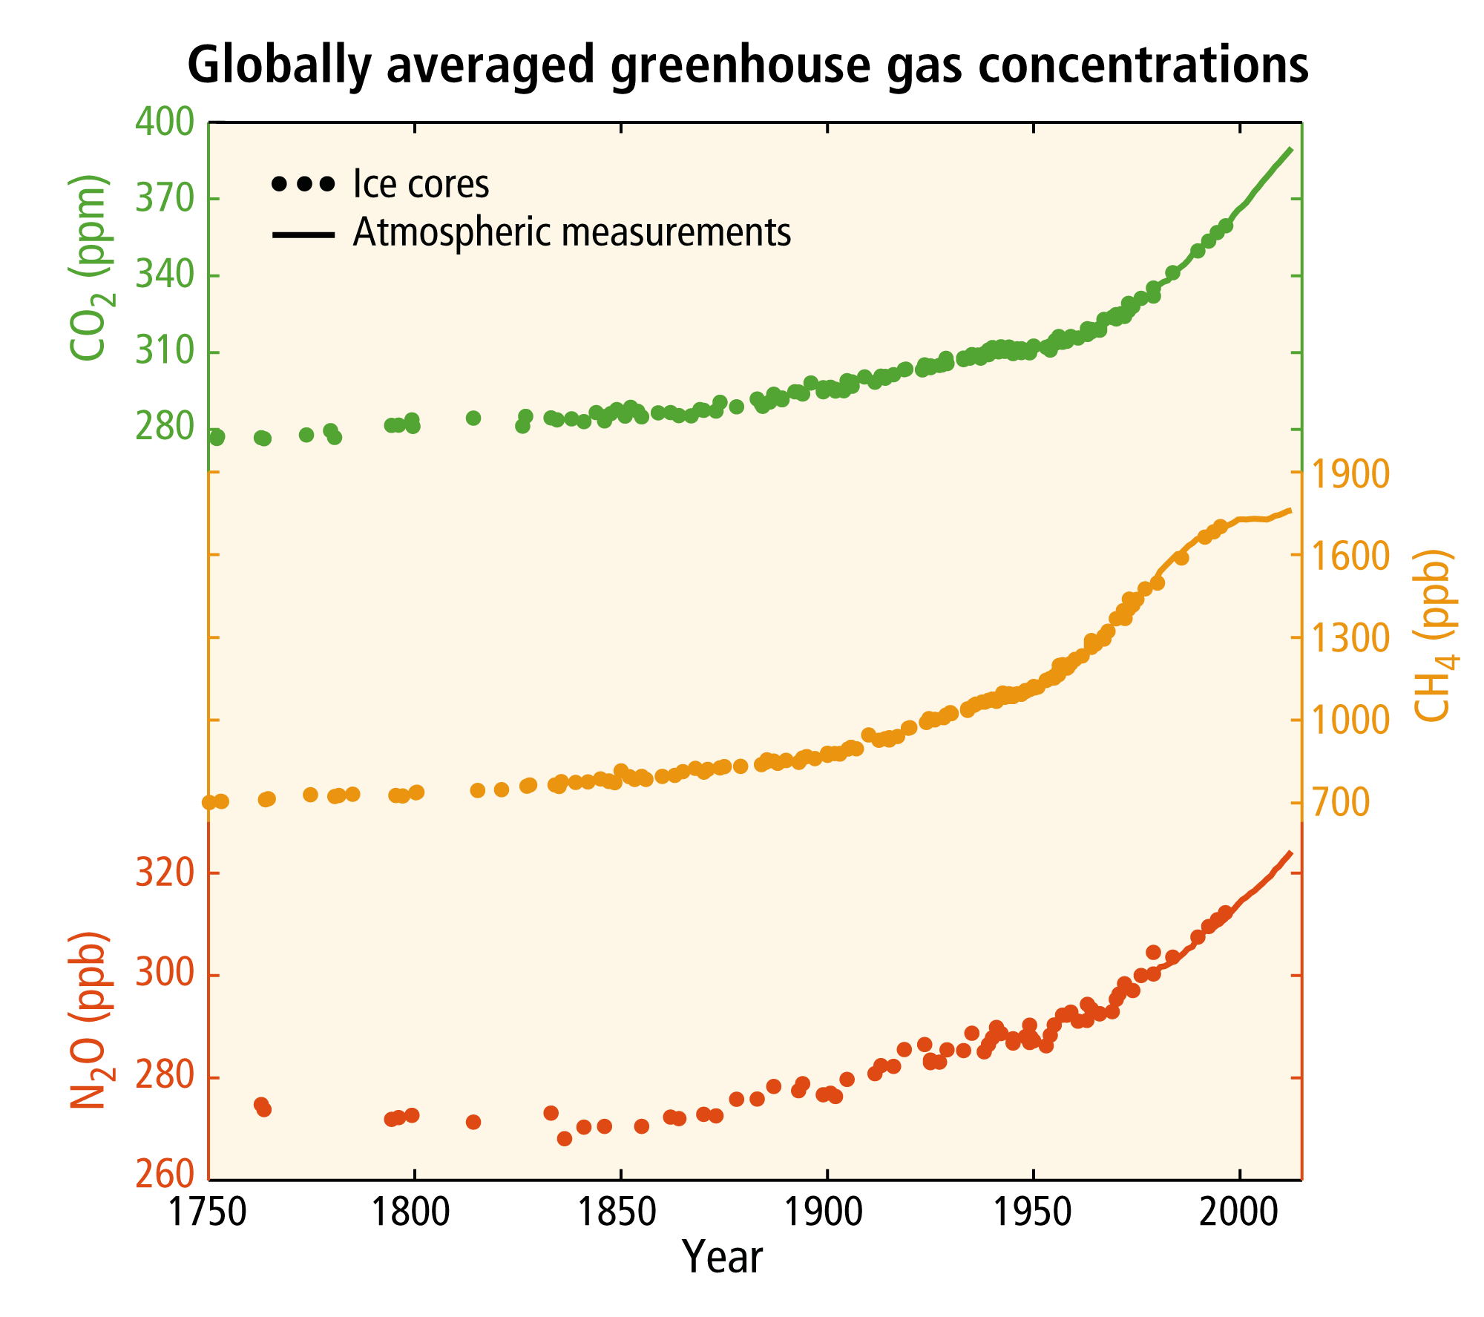
Trends
Increases in all types of greenhouse gases since industrial revolution in 1800s
(IPCC, 2014)
Notes:
If you look at the chart on the right, you can see that global greenhouse gas emissions have only increased since the industrial revolution in the 1800s and continues to increase rapidly until today. These include all three GHGs we have mentioned below. Today, GHG levels sit at 400 ppm for co2, 1900 ppb for ch4, and 320 ppb for n2O
These trends are incredibly worrying as they do continue to grow and trap more heat in the atmosphere. In the next part, we explain some of the human causes of these gas increases.
https://ar5-syr.ipcc.ch/topic_observedchanges.php

Slide 8
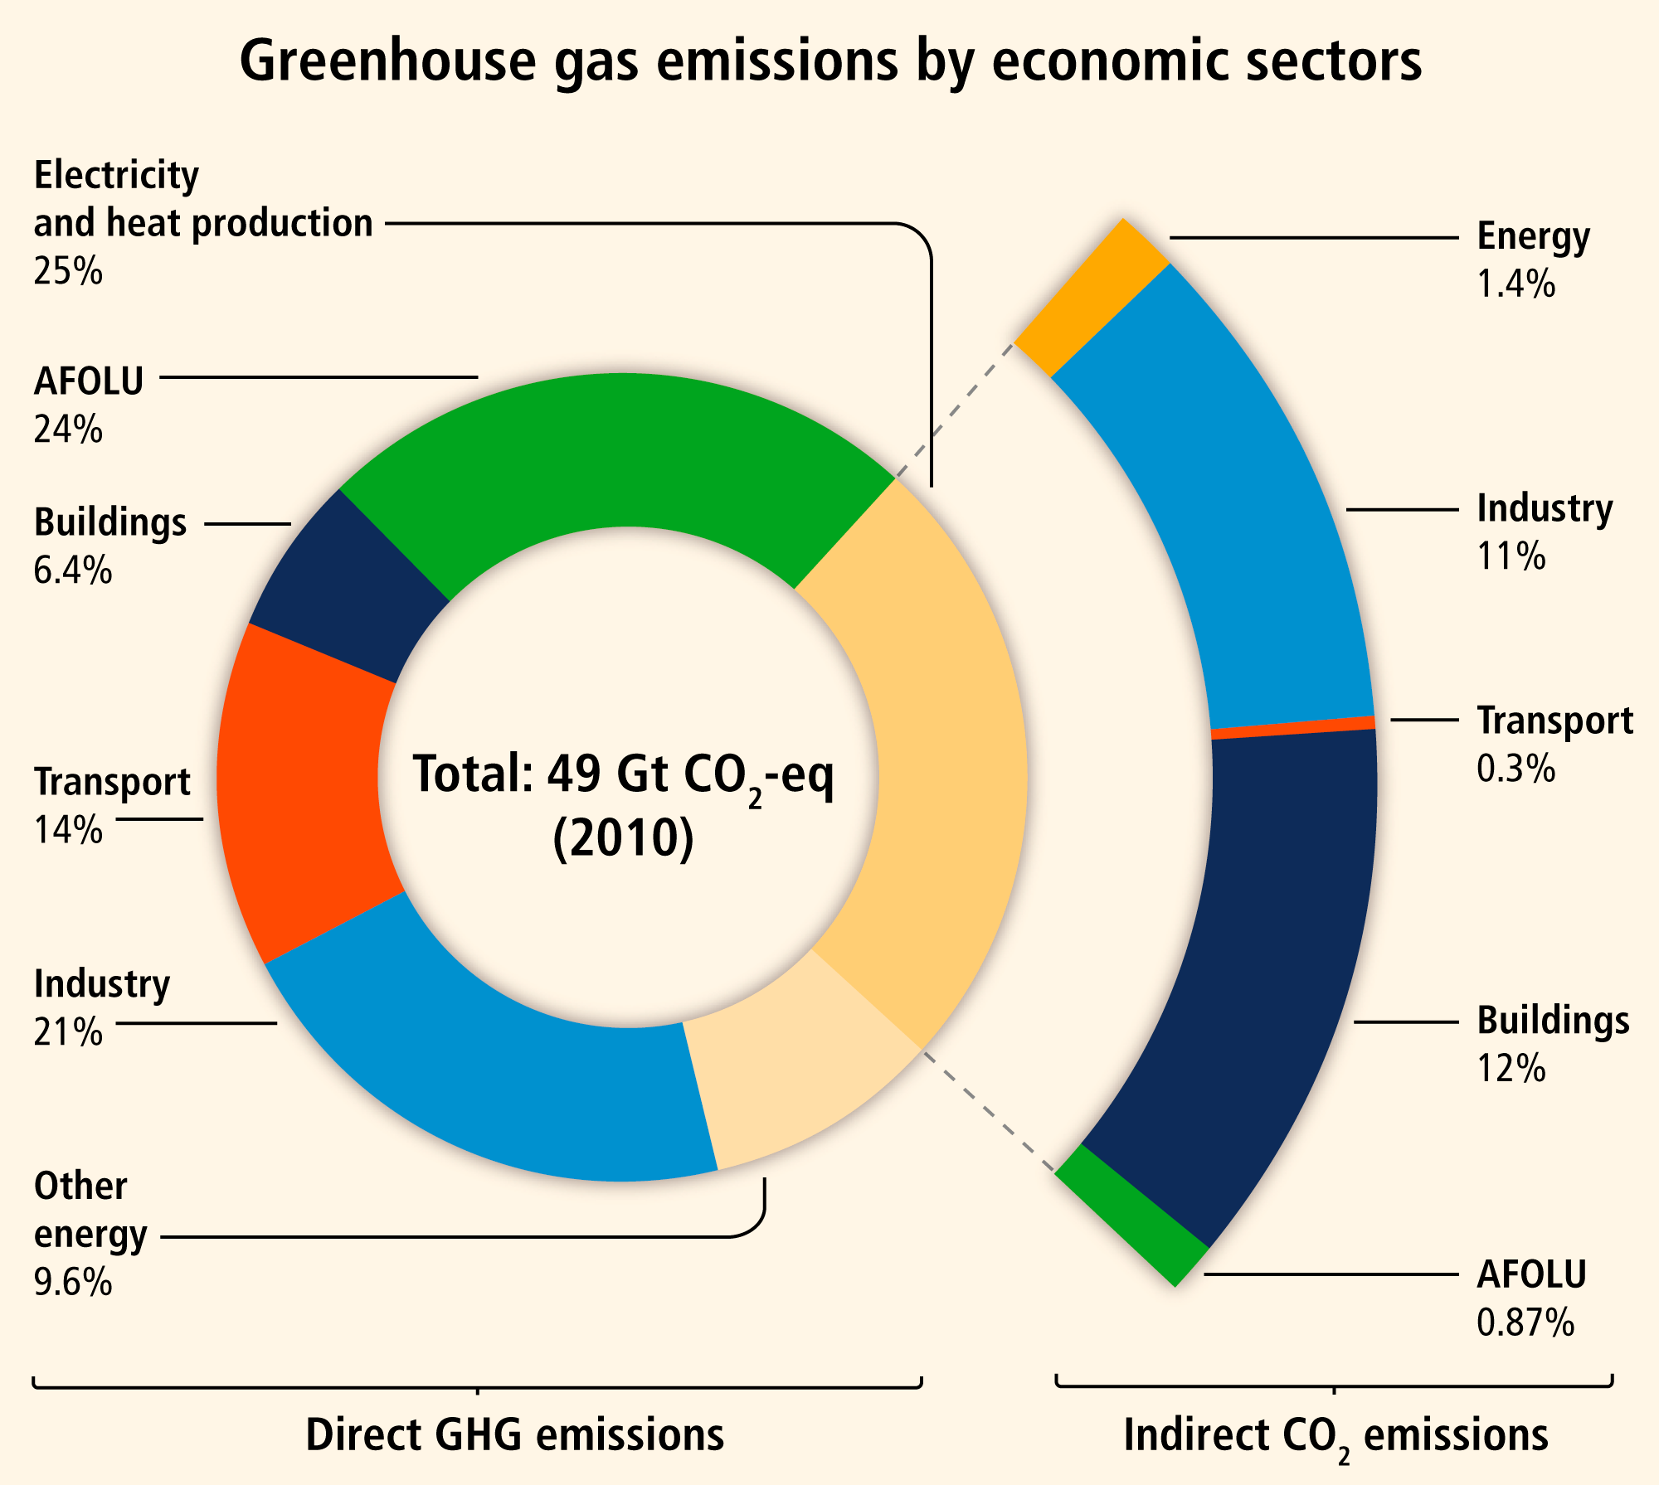
(IPCC, 2014)
Human GHG Sources
Notes:
https://ar5-syr.ipcc.ch/topic_observedchanges.php

Slide 9
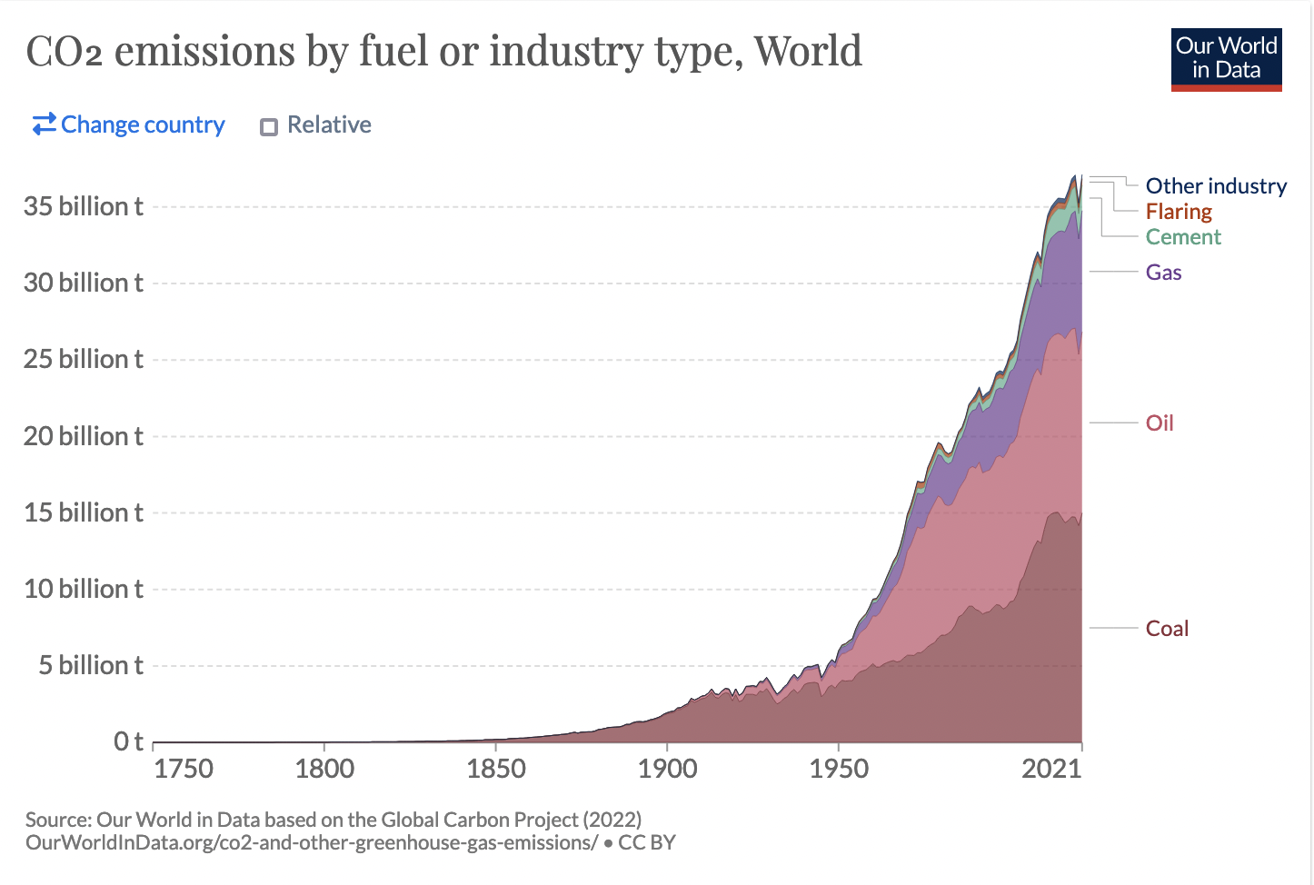
Human sources of CO₂
Fossil fuel combustion
Factory / Industry emissions
Car exhaust
Deforestation
Original data from (Olivier & Peters, 2020)
Notes:
https://www.pbl.nl/sites/default/files/downloads/pbl-2020-trends-in-global-co2-and_total-greenhouse-gas-emissions-2020-report_4331.pdf

Slide 10
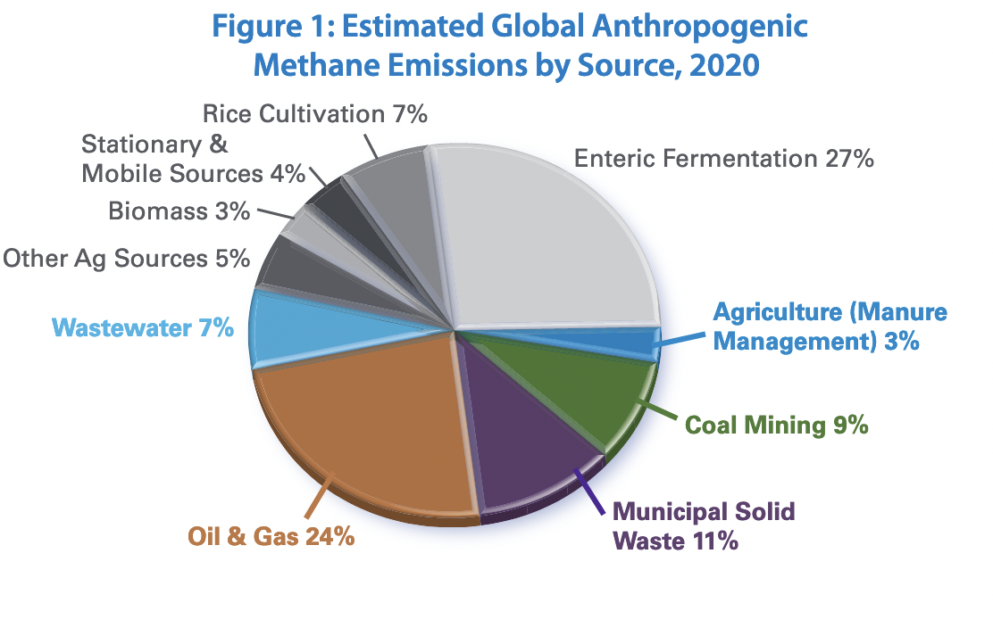
[Human] sources of CH₄
Diagram from (Global Methane Initiative, 2022), Data from (EPA, 2012)
Notes:
https://www.globalmethane.org/documents/gmi-mitigation-factsheet.pdf

Slide 11
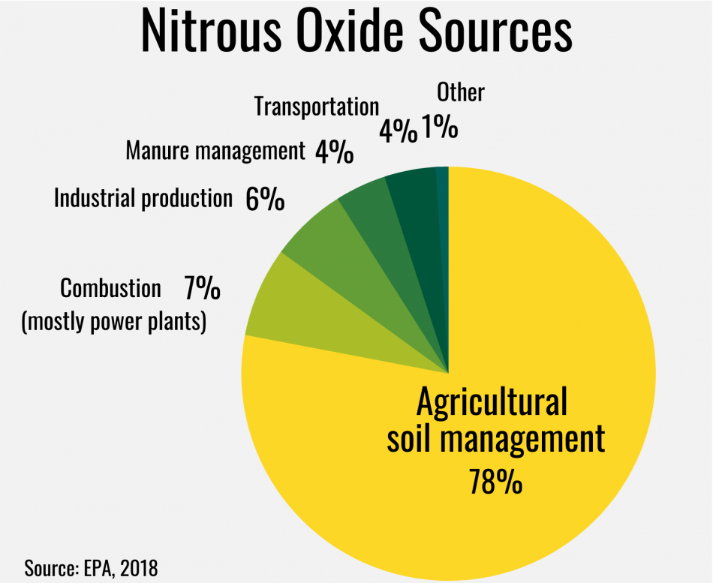
Sources of Nitrous Oxide
(EPA, 2022)
Notes:
https://cals.ncsu.edu/crop-and-soil-sciences/news/measuring-greenhouse-gases-starts-in-soil/
EPA

Slide 12
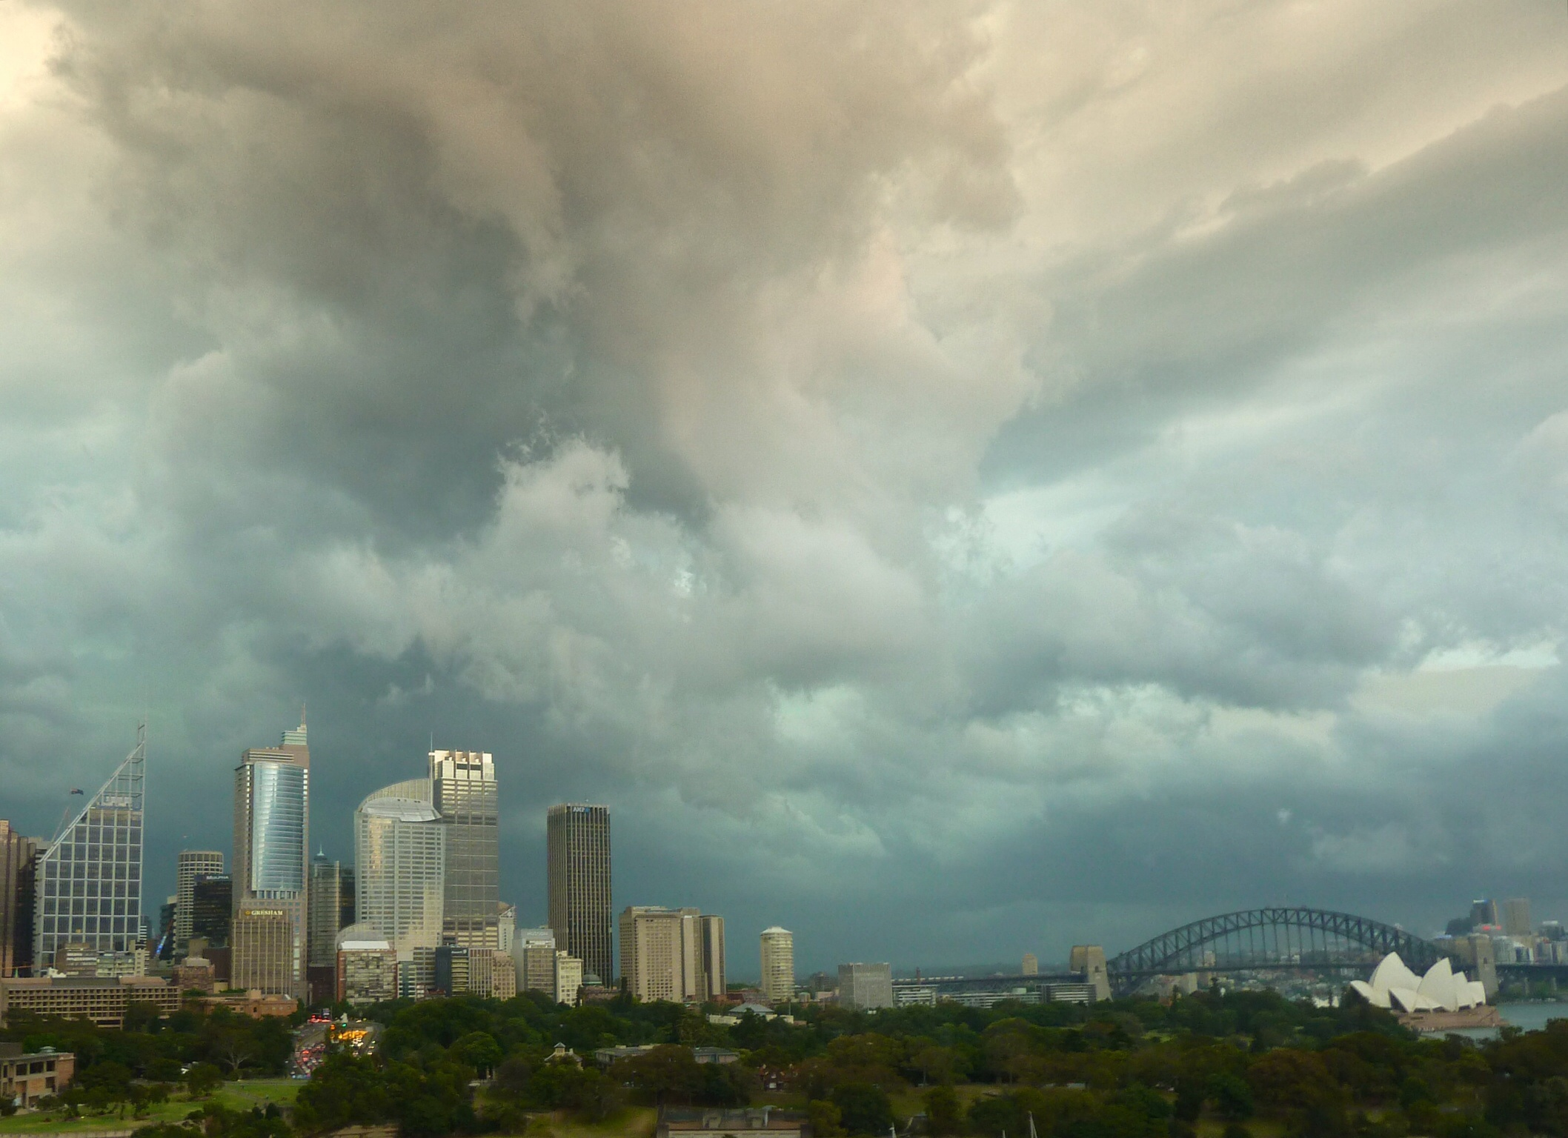
Elevated levels of water vapor
Air can hold more water at higher temperature
As climate warms due to other gasses, air hold more water vapor
Forms positive feedback loop

Slide 13
Oh no! How can our fragile ecosystems cope?
Let’s zoom in

Slide 14
Unit 2
Explain how extinction rates today compare with those in the past.
Give examples of how different environments give rise to differences in the structure and function of organ systems of plants and animals.

Slide 15
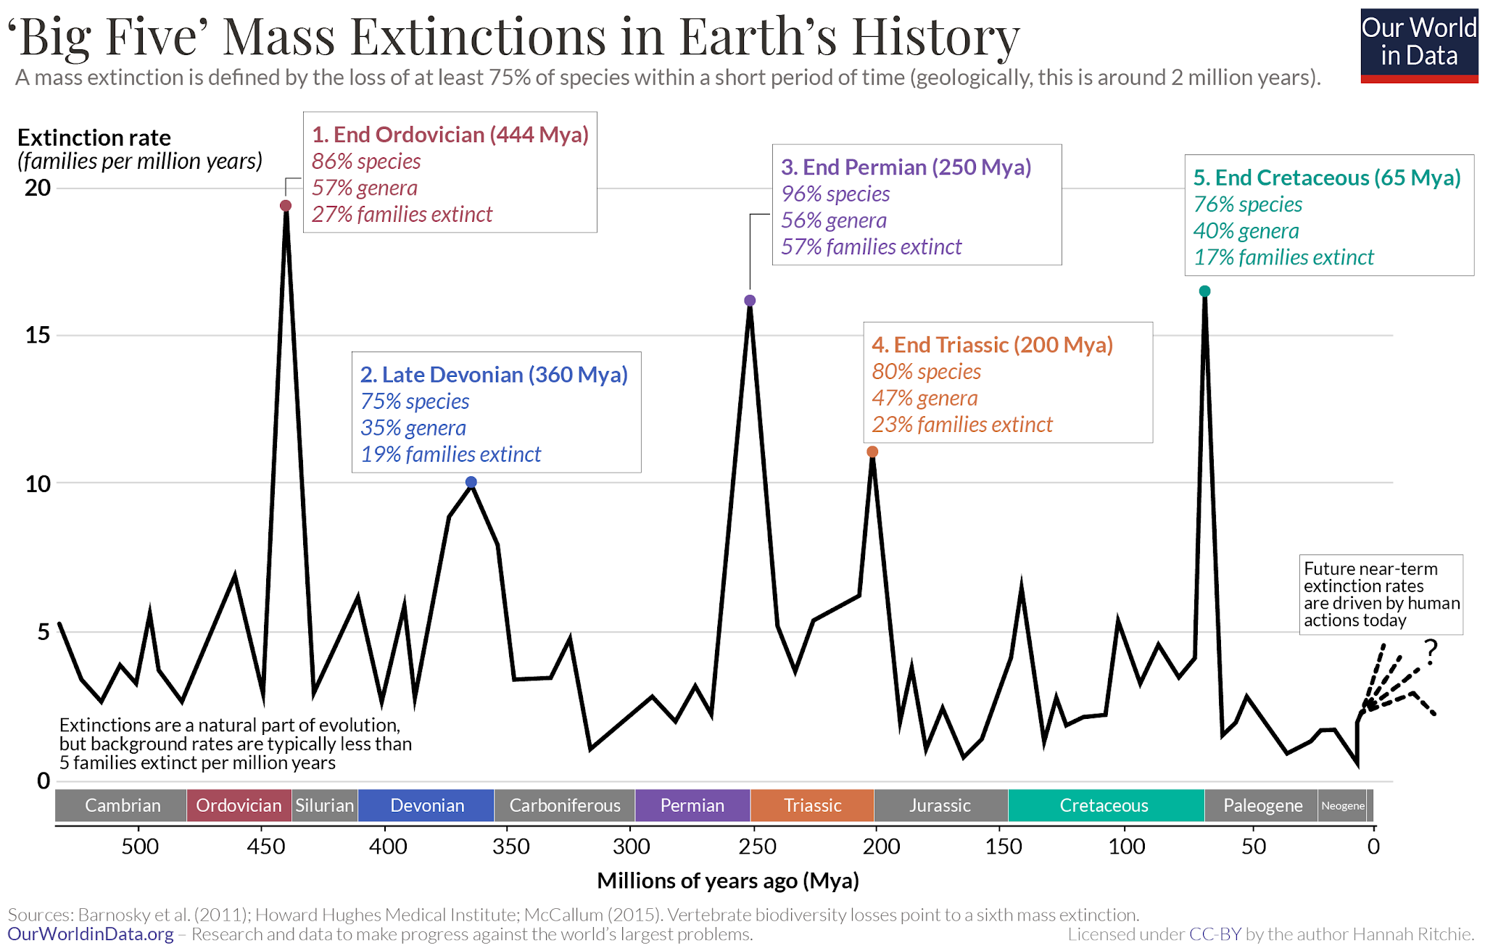
Historical Extinction Rates
Extinctions are natural - organisms regularly go extinct
Mass extinction - over 75% of species go extinct
5 mass extinction events in the last 500 million years
Notes:
First I will discuss about historical extinction rates. Extinctions are natural and organisms regularly go extinct even without any consequences of human actions. However, mass extinctions are a lot more rare. Mass extinctions are defined as a period of time where over 75% of species to extinct. There have been 5 mass extinction events that have occurred over the last 500 million years. These events are primarily caused by natural causes, such as volcanic eruptions and asteroid impacts. These events line up with the spikes in the chart on the right.

Slide 16
Current Extinction Rates
Human behaviour causing higher than average extinction rates
Climate change, pollution, deforestation, etc.
While still early, we might be at the start of a new mass extinction event (Holocene extinction)
Notes:
Ever since the start of the industrial revolution, we have been releasing a lot of greenhouse gases to the atmosphere, polluting waters and clearing forests to build homes, attributing to rising global temperatures, increasing ocean acidity levels, and habitat loss. All these actions have negative impacts to the survival of other organisms. For example, the rising ocean temperatures and increasing ocean acidity levels are killing large amounts of sea organisms like coral reefs, and many land organisms are increasingly becoming endangered due to habitat loss from deforestation. As a result of all these human actions, currently we are noticing a higher than average extinction rates compared to in the past. While it is still relatively early for us to notice this, we may be at the start of a new mass extinction events, the holocene extinction, caused primarily by humans.

Slide 17
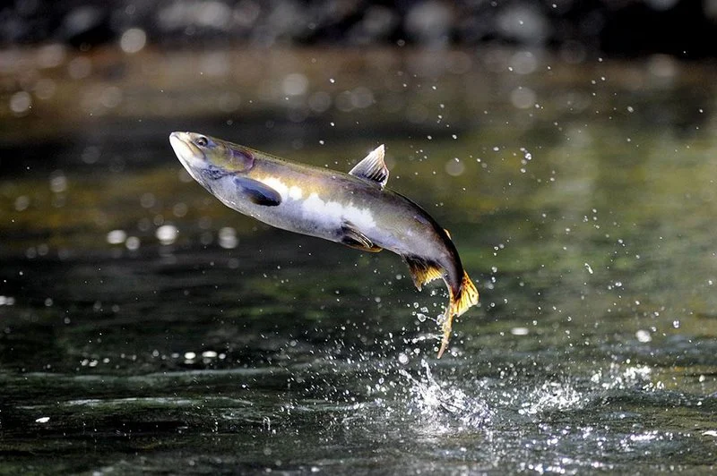
Example: Pink salmon migration patterns
Pink salmon are migrating 2 weeks earlier than it was 40 years ago
Directional selection for earlier migration timing,
Results in a substantial decrease in the late-migrating phenotype
Late migrators now only represent 10% of population
Temperature of river increased by 1°C
(Kovach et al., 2012)
Notes:
A study has shown that pink salmon are migrating 2 weeks earlier than they did 40 years ago. Evidence shows that there has been directional selection for earlier migration timing, which results in a decrease in the late-migrating phenotype. It now only makes up less than 10% of the pink salmon population. This is due to the increase in temperature due to climate change.
This is one of the many examples of how climate change is affecting earth’s organisms

Slide 18
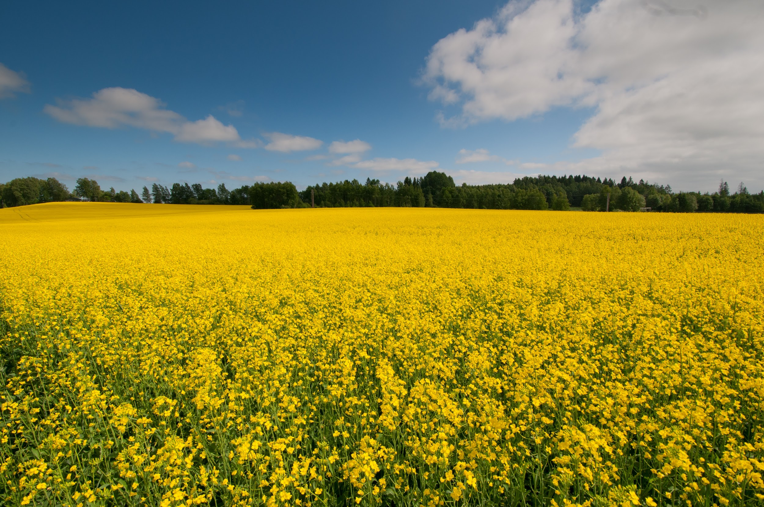
Example 2: Weedy field mustard
Compared plant from 1997 and 2004,
Where five-year drought occurred in 2000
Plants now flower a few days earlier during the shorter wet season.
No environmental differences
(Franks et al., 2007)

Slide 19
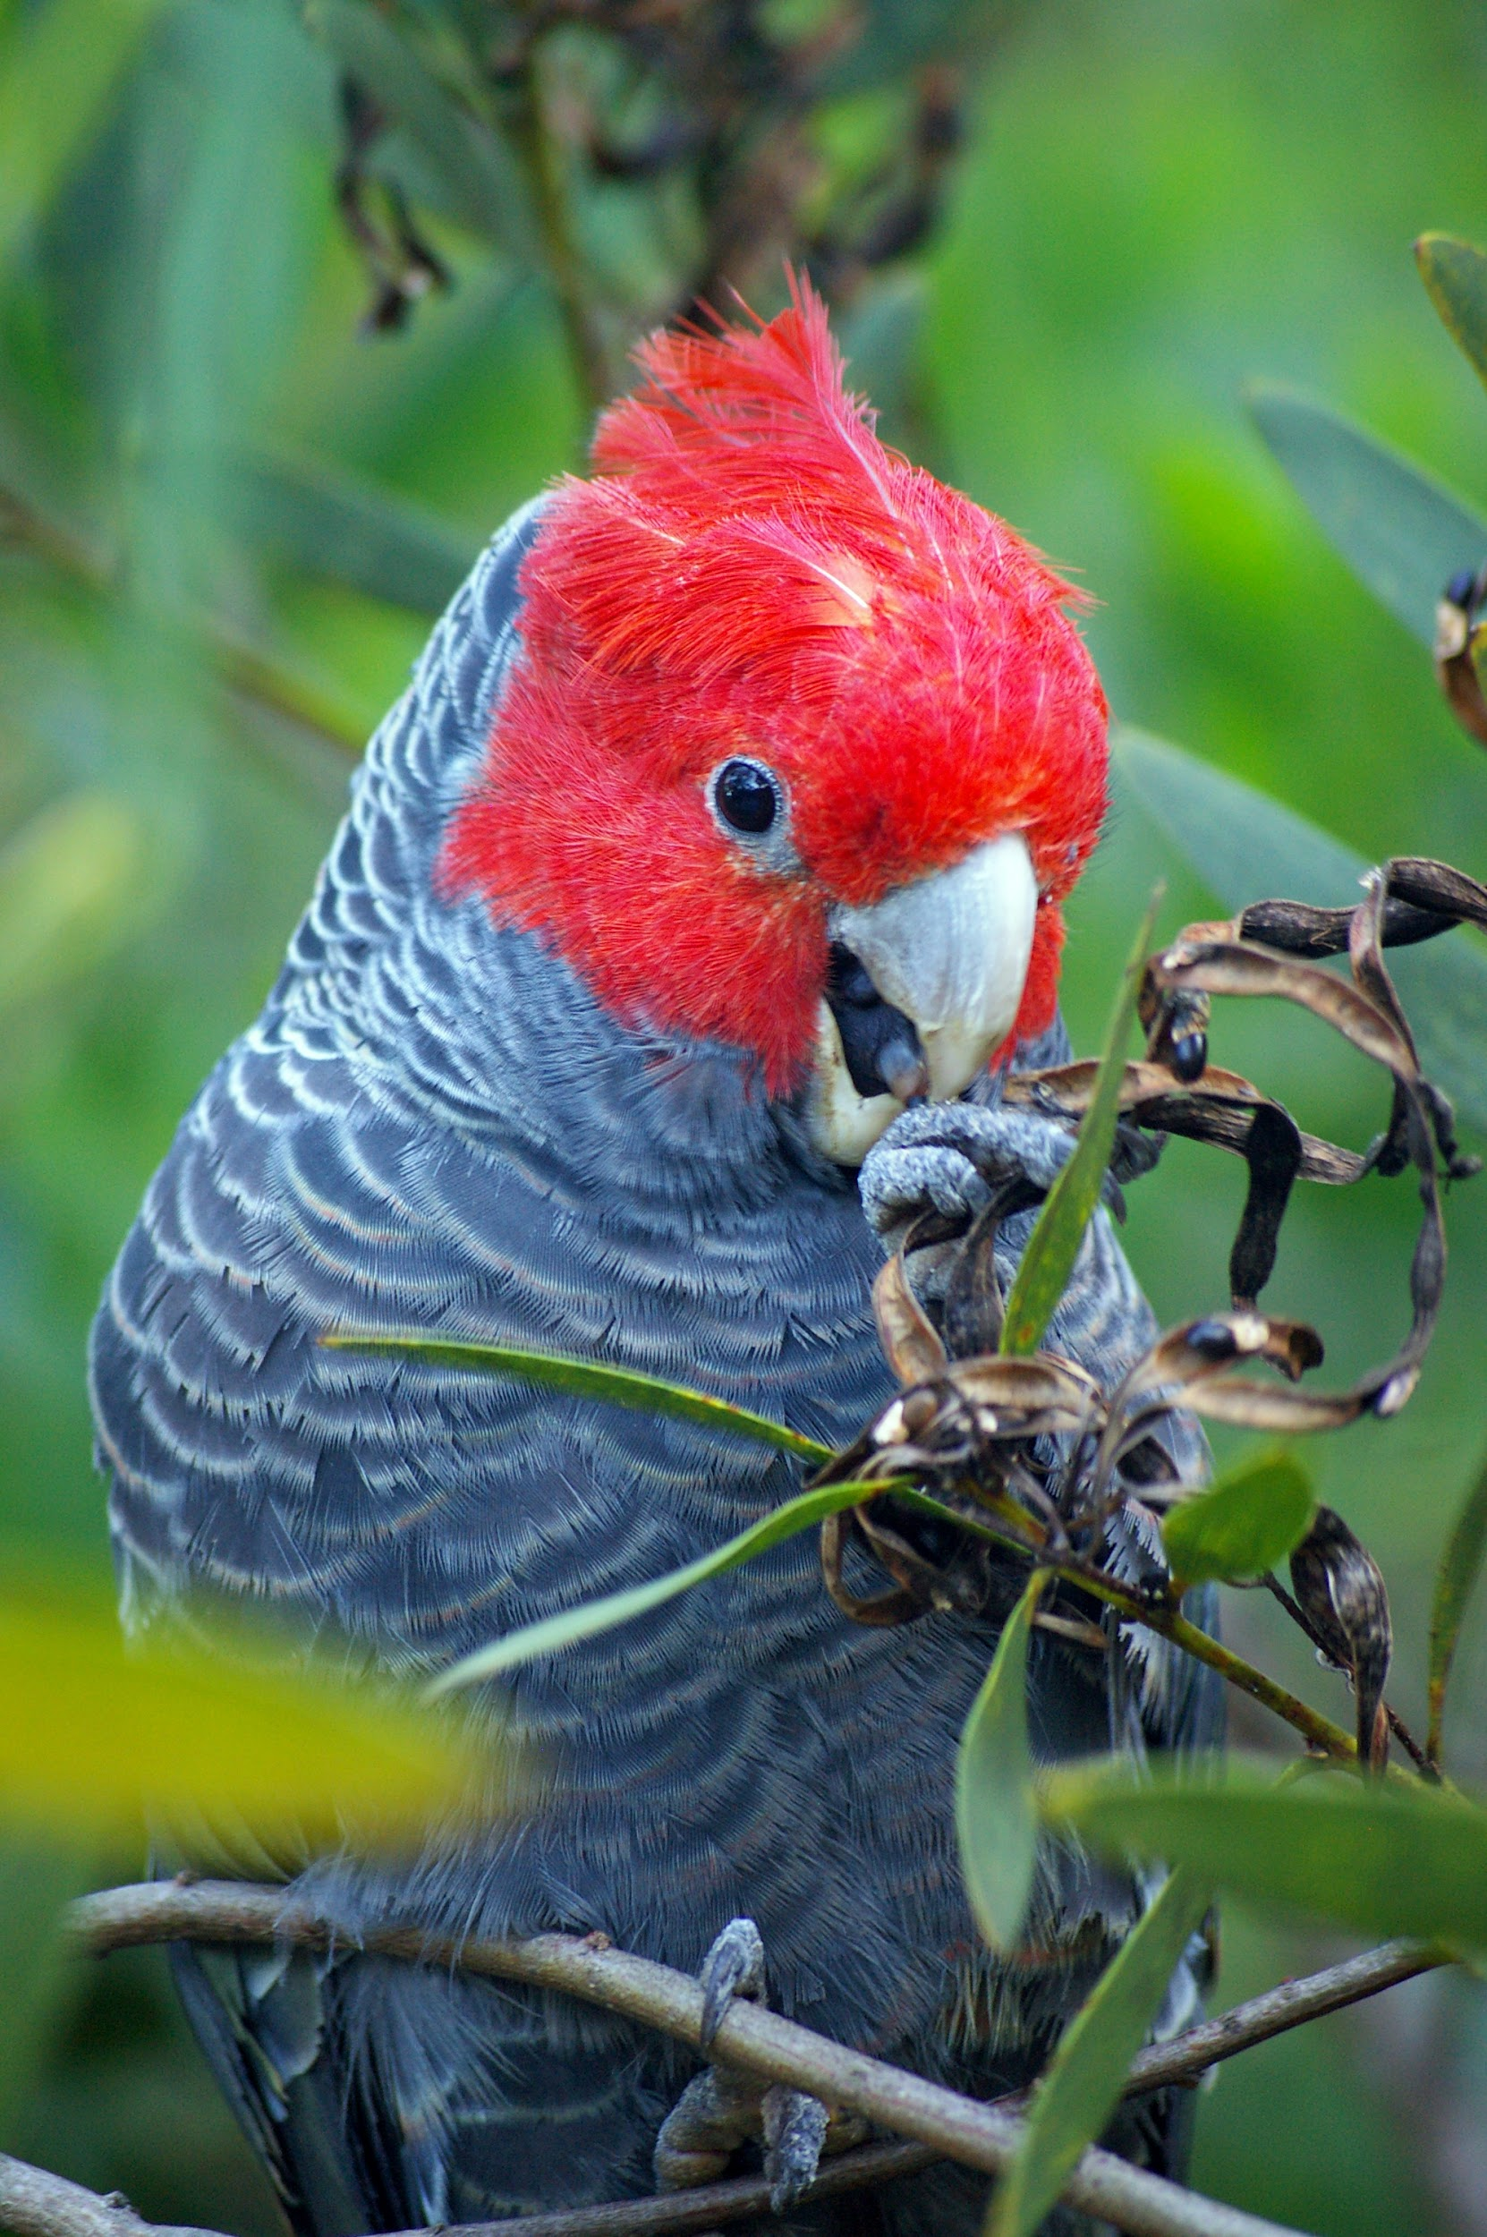
Example 3: Parrot structure and function
Investigation into beak size of Australian parrots
Beak size of gang-gang cockatoo and red-rumped parrot increased by 4-10% since 1871
Likely to mitigate thermal stress by climate warming
(Campbell-Tennant et al., 2015)
Notes:
TL:DR:
Aim
Allen's rule posits that the appendages of endothermic organisms will be larger in warmer climates to allow for dumping of heat loads. Given a link between appendage size and climate, we tested the prediction that climate change has driven the evolution of larger bills in birds, resulting in measurable changes over the recent past.
Location
Australia.
Methods
We explored geographical and temporal variation in bill surface area of five Australian parrot species to determine whether individuals from warmer climates have larger bills, and whether there have been increases in bill surface area over time, consistent with climatic warming. Measurements were obtained from museum specimens dating from 1871 to 2008. These data were then related to geographical location, collection date and locality-specific climate data, in order to construct and compare models of spatio-temporal and climate-related variation in bill morphology.
Results
There have been increases in bill surface area in mulga parrots (Psephotus varius), gang-gang cockatoos (Callocephalon fimbriatum), red-rumped parrots (Psephotus haematonotus) and male crimson rosellas (Platycercus elegans), equating to a c. 4–10% increase in bill surface area since 1871. Average maximum summer temperature in the 5 years prior to specimen collection also positively predicted bill surface area in mulga parrots, red-rumped parrots and crimson rosellas, consistent with Allen's rule. With the exception of red-rumped parrots, however, models with geographical location and year of collection were still better predictors of bill surface area than local climate at the date of collection.
Main conclusions
Our analysis provides evidence that four species of parrot have exhibited adaptive change in bills over the past century potentially mitigating the thermal stress caused by climatic warming. Although consistent with the predicted effects of climate change, the temporal patterns we observe may have additional causes, however, such as changes in primary productivity, habitat or food availability.

Slide 20
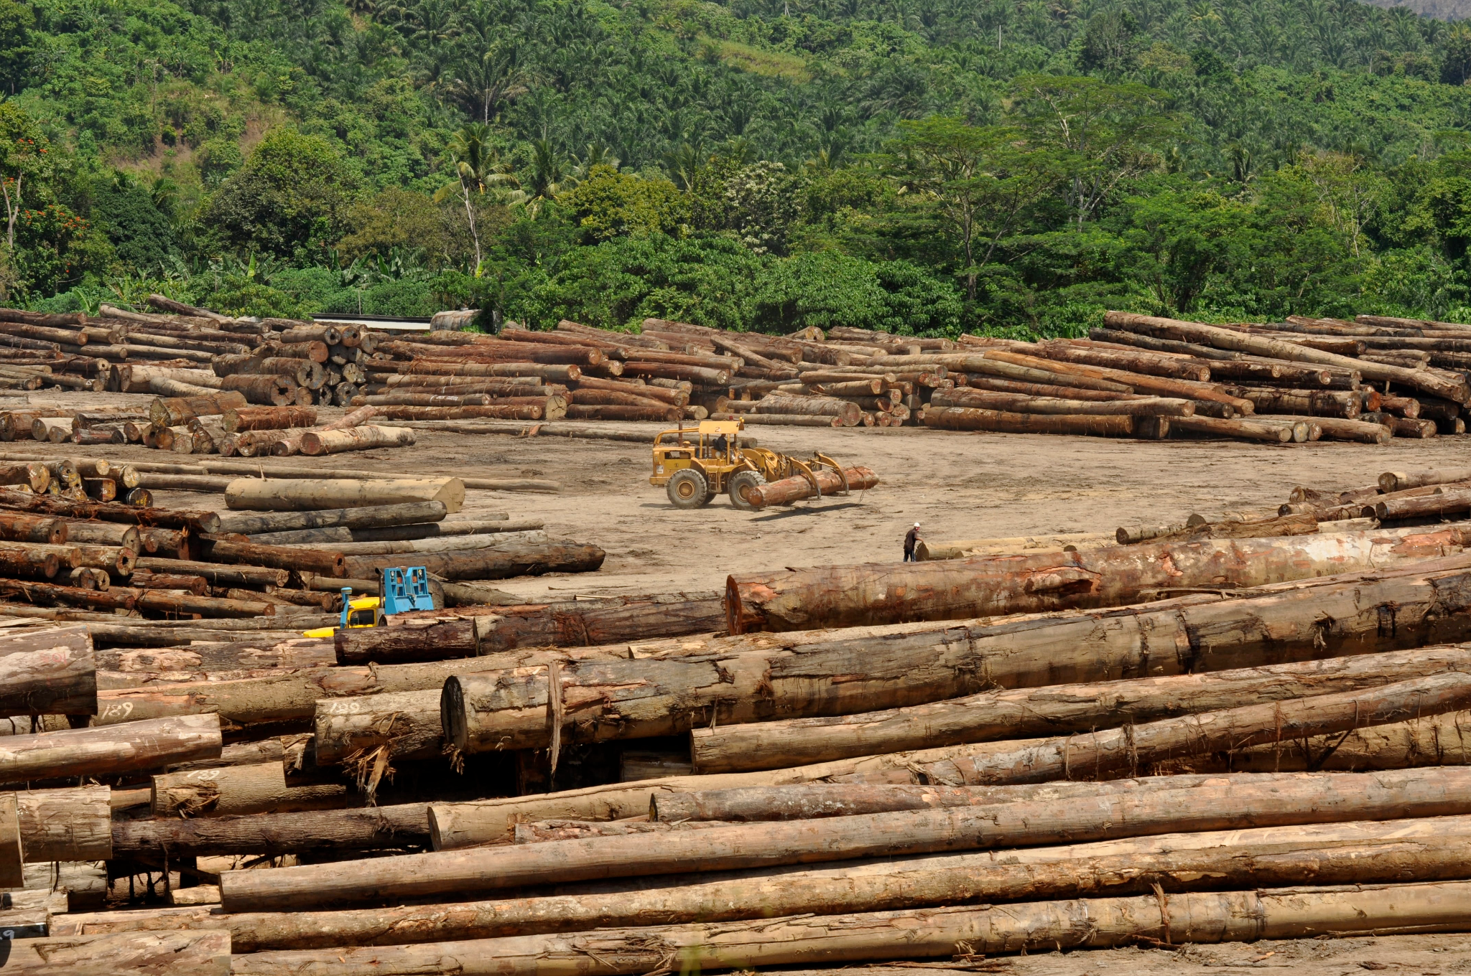

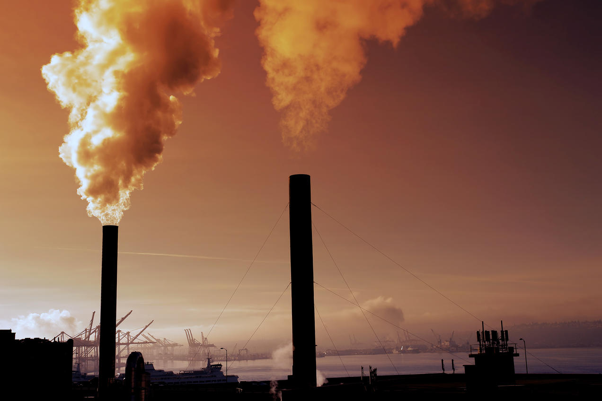
population responses to climate change
Notes:
The rapid increase in population is one of the main reasons for global warming. At the same time, it is also a serious threat to the balance between natural ecosystems. With such a large population, the amount of carbon dioxide emitted each year by itself alone will be a staggering figure, which will directly lead to a continuous increase in the amount of carbon dioxide in the atmosphere, the "greenhouse effect". This will affect the climate change on the earth's surface. Other causes of human-made climate rise are massive deforestation, because trees store carbon, and once the forest is cut down, most of the stored carbon will be released again into the atmosphere as carbon dioxide. There are also atmospheric pollution factors, a lot of human activity like burning fossil fuels, vehicle emissions, and emissions from agriculture and industry all contribute to the global warming.

Slide 21
Unit 3
Describe population responses to climate change
Discuss local (within British Columbia) consequences of the heat dome of 2021 to terrestrial and marine ecosystems

Slide 22
And it gets worse…
Let’s go back to 2021

Slide 23
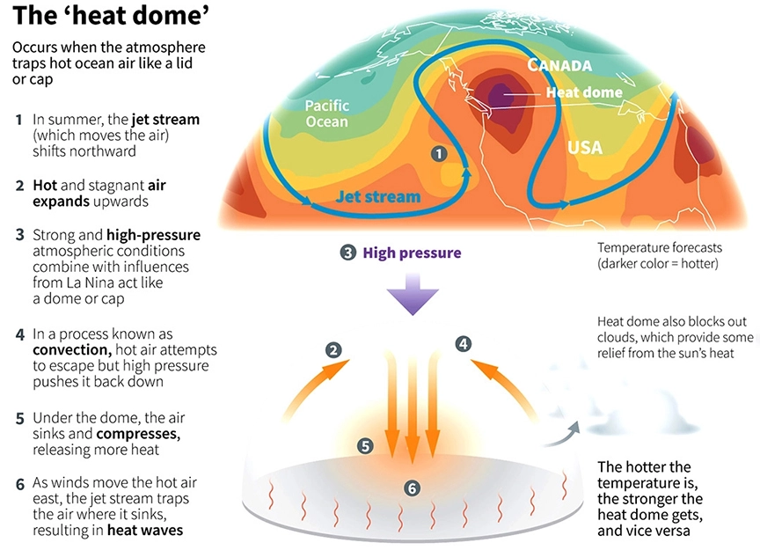
The Heat Dome of 2021
https://www.drishtiias.com/to-the-points/paper1/heat-waves-and-heat-dome
Notes:
A heat dome occurred in 2021, and British Columbia was one of the many places affected by the heat dome. But first, we must know what a heat dome is. A heat dome is when when the atmosphere traps hot ocean air like a lid or cap.
Canada recorded a record temperature in British Columbia (121.3°F)

Slide 24
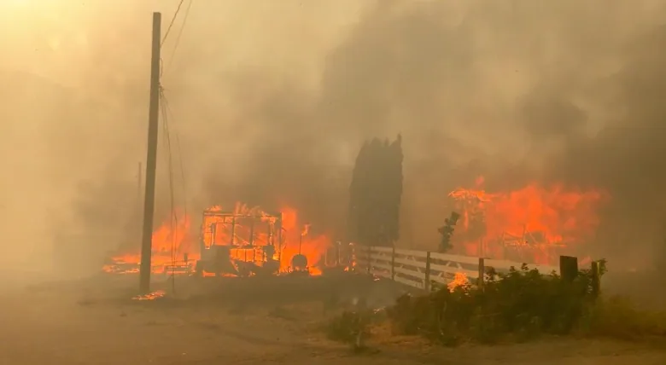
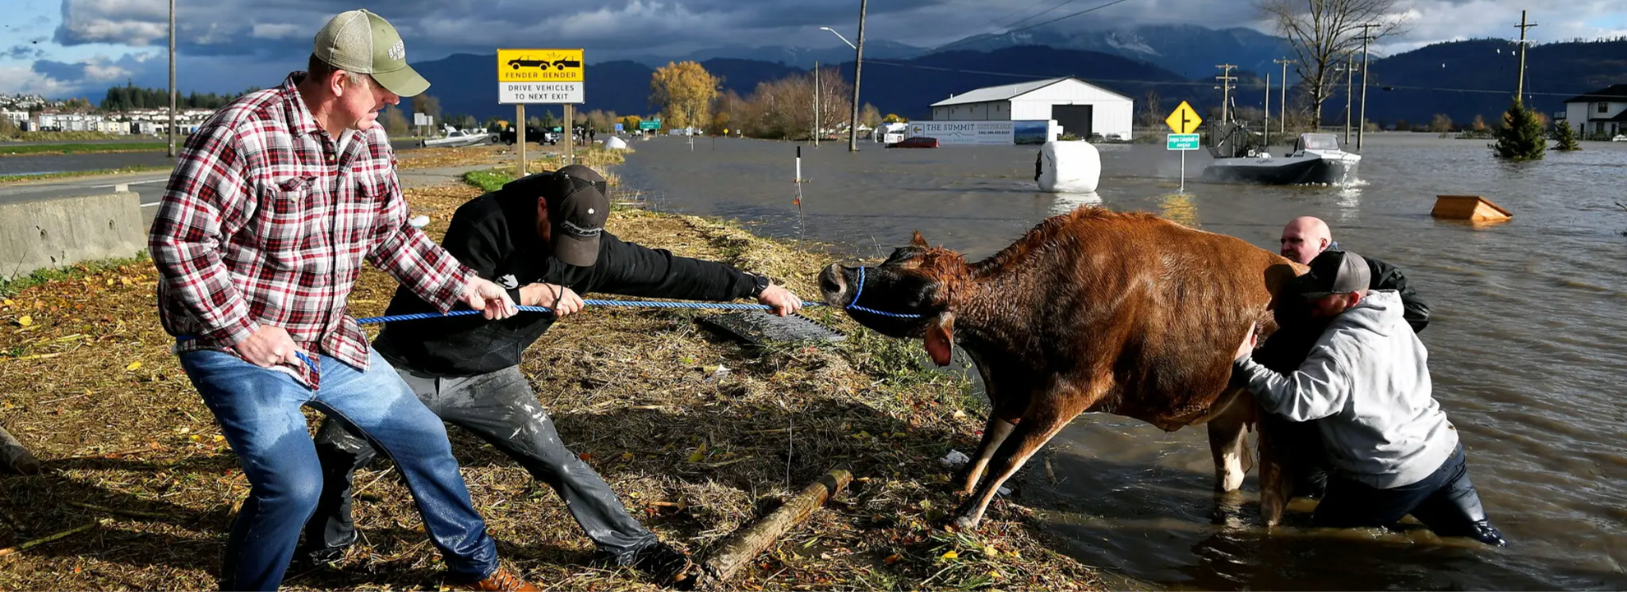
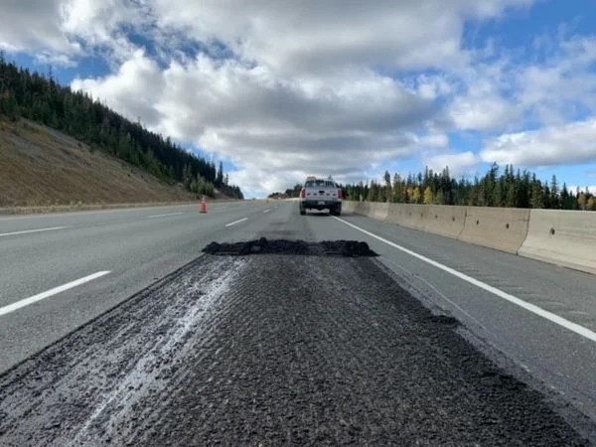
The Effects of the Heat Dome
Wildfires
Destroyed the village of Lytton
Damaged infrastructure
Rails and roads
Economic loss
Closed businesses
Damaged crops --(maybe)--> Higher food prices
Melted snowcaps
Flooding in some areas
Village of Lytton
https://www.cbc.ca/news/canada/british-columbia/bc-wildfires-june-30-2021-1.6085919
Flood in Abbotsford
https://www.nytimes.com/2021/11/21/canada-flooding-climate-change.html
Coquihalla Highway
https://www.nytimes.com/2021/11/21/canada-flooding-climate-change.html
Notes:
The heat dome caused a lot of wildfires, one of them reaching the village of Lytton in british Columbia. As you can see in the picture, the village was badly destroyed. The damage didn’t stop there. The heat also damaged both rail and road infractures. It caused rutting in the roads, and also causing landslides, which in turn caused transportation problems. The heat dome also caused some businesses and schools to be closed temporarily due to record high temperatures. It also caused flooding in some places due to the melting of snow caps. Finally, the heat also caused crops to be damaged, which is expected to increase the food prices of the following years.

Slide 25
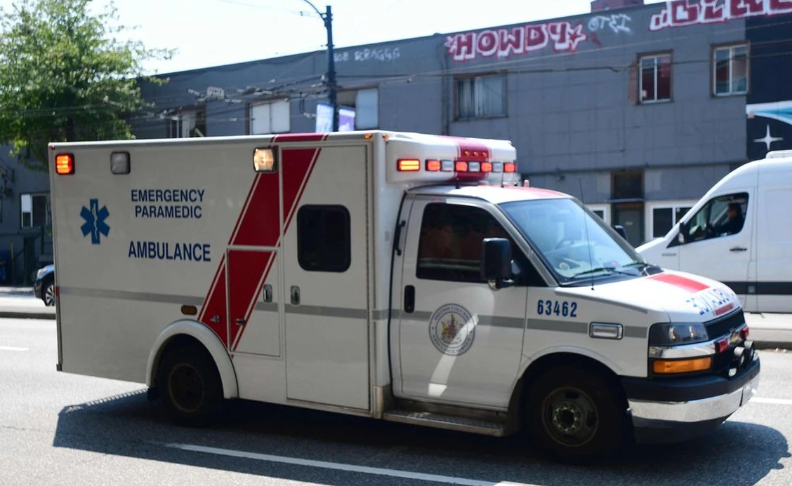
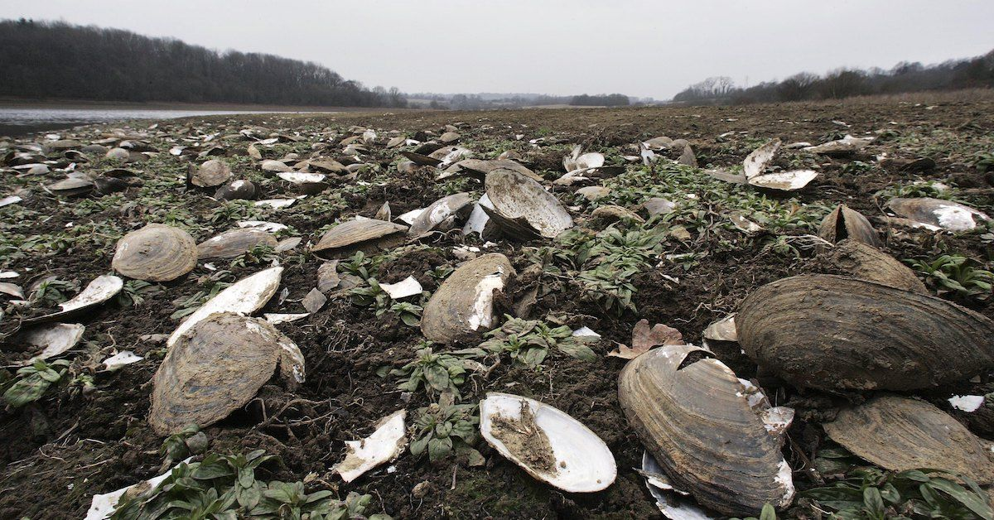
The Effects of the Heat Dome
Approximately 619 deaths were confirmed to have had heat-related causes
Mostly people of old age, people of low income
MORE THAN A BILLION marine life
Farm animals
Ambulance in Vancouver
https://vancouversun.com/health/local-health/the-434-in-metro-vancouver-who-died-in-heat-dome-mostly-elderly-poor-isolated-female
Dead marine life
https://www.greenmatters.com/p/heat-dome-marine-life
Notes:
The effects didn’t stop there. The heat dome also took the lives of humans and animals alike. It is estimated that 619 deaths were due to heat-related causes. A majority of the people who passed away were the elderly and poor. This is because they have less access to air conditioning.
According to the prediction of Chris Harley, a professor in the University of British Columbia, approximately more than one billion sea creatures died due to the heat dome
Farm aninmals, such as chickens or cows also died due to high temperatures or flooding

Slide 26
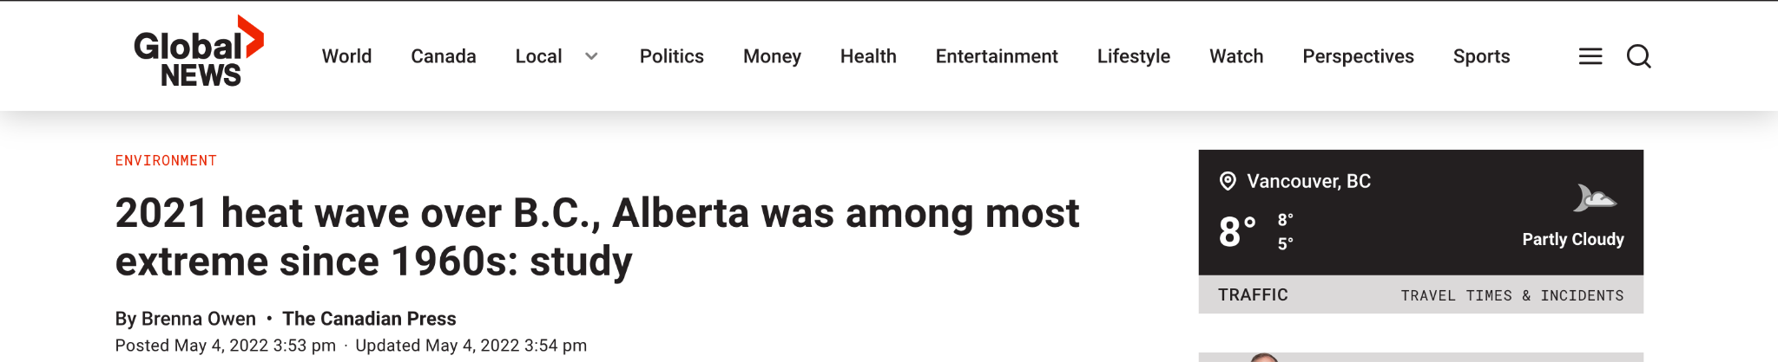
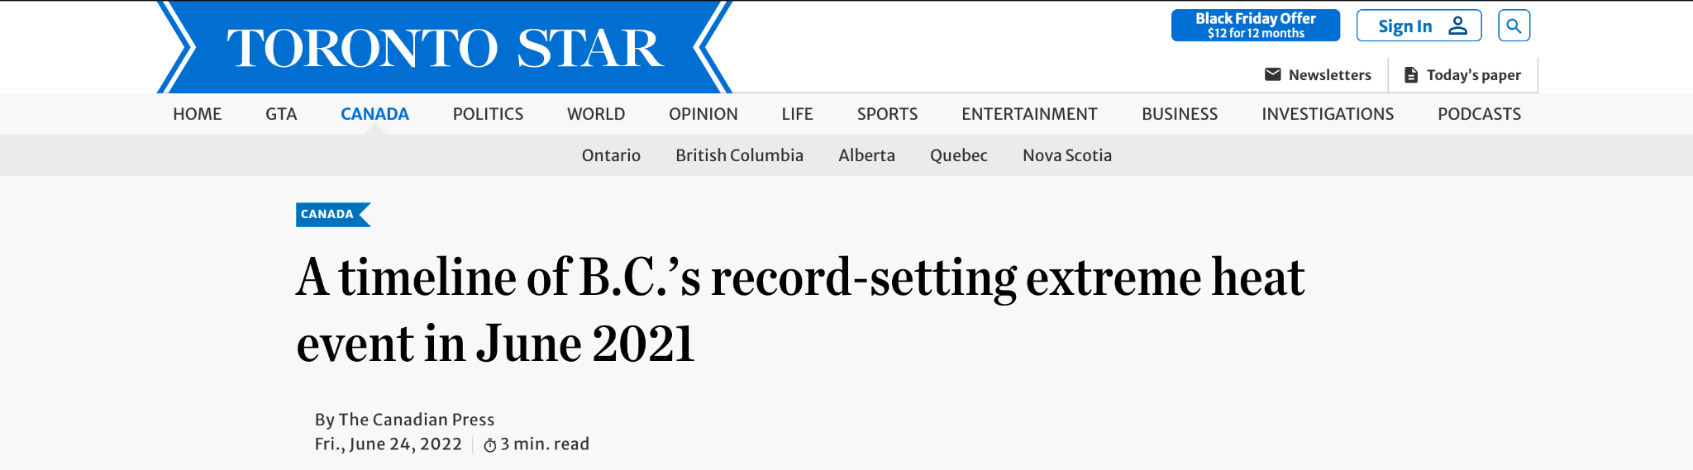

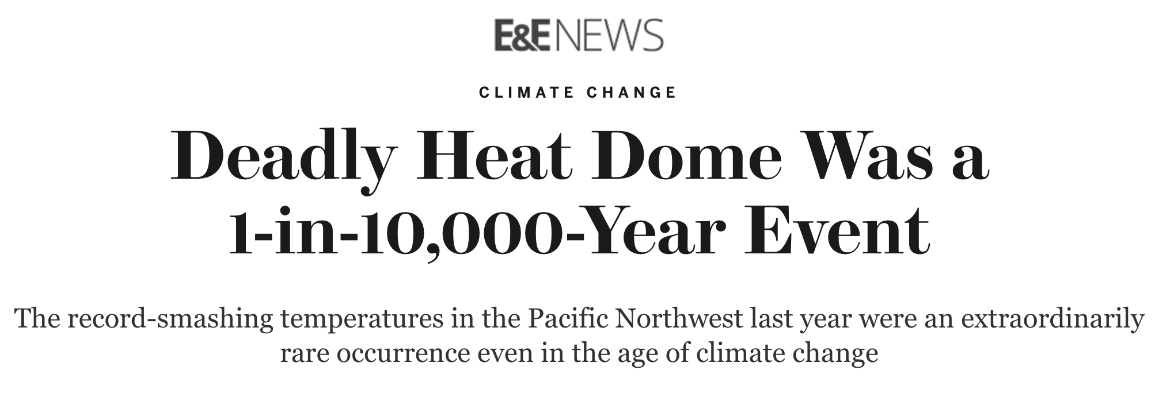
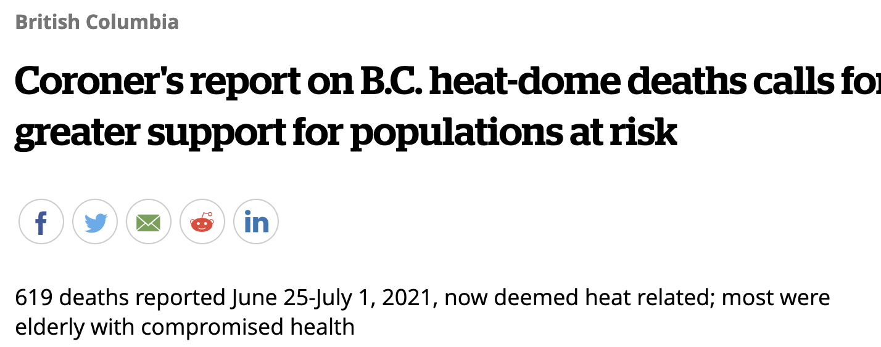
This is a preview of what climate change can do
Notes:
Although climate change does not directly cause a heat dome, its effects make heat domes more frequent, more intense, and as a result, more deadly

Slide 27
And this was in British Columbia alone…

Slide 28
The End
Notes:
The takeaway of this video is that climate change is already causing adverse effects to humans and animals alike. We should focus more on this problem rather than waiting until it is too late

Slide 29
References
Intergovernmental Panel on Climate Change. 2014. Topic 1: Observed changes and their causes. IPCC 5th Assessment Synthesis Report. [accessed 2022 Nov 21]. https://ar5-syr.ipcc.ch/topic_observedchanges.php
Olivier JGJ, Peters JAHW. 2020. PBL Netherlands Environmental Assessment Agency.[accessed 2022 Nov 21]. https://www.pbl.nl/sites/default/files/downloads/pbl-2020-trends-in-global-co2-and_total-greenhouse-gas-emissions-2020-report_4331.pdf
Global Methane Initiative. Global methane initiative. Global Methane Emissions and Mitigation Opportunities. [accessed 2022 Nov 21]. https://www.globalmethane.org/documents/gmi-mitigation-factsheet.pdf
U.S. Environmental Protection Agency (EPA). 2012 Dec. Global Anthropogenic Emissions of Non-CO2 Greenhouse Gases: 1990–2030. EPA. [accessed 2022 Nov 21]. https://www.epa.gov/global-mitigation-non-co2-greenhouse-gases/global-non-co2-ghg-emissions-1990-2030
United States Environmental Protection Agency. 2022 May 16. Overview of Greenhouse Gasses. EPA. [accessed 2022 Nov 21]. https://www.epa.gov/ghgemissions/overview-greenhouse-gases

Slide 30
References 2
Kovach RP, Gharrett AJ, Tallmon DA. 2012. Genetic change for earlier migration timing in a pink salmon population. Proceedings of the Royal Society B: Biological Sciences 279:3870–3878.
Franks SJ, Sim S, Weis AE. 2007. Rapid evolution of flowering time by an annual plant in response to a climate fluctuation. Proceedings of the National Academy of Sciences 104:1278–1282.
Campbell-Tennant DJ, Gardner JL, Kearney MR, Symonds MRE. 2015. Climate-related spatial and temporal variation in bill morphology over the past century in Australian parrots. Journal of Biogeography 42:1163–1175.
The National Wildlife Foundation. Venus Flytrap. NWF. [accessed 2022 Nov 21]. https://www.nwf.org/Educational-Resources/Wildlife-Guide/Plants-and-Fungi/Venus-Flytrap
The National Wildlife Foundation. Cacti. NWF. [accessed 2022 Nov 21]. https://www.nwf.org/Educational-Resources/Wildlife-Guide/Plants-and-Fungi/Venus-Flytrap
The Government of British Columbia. Douglas-fir. [accessed 2022 Nov 21]. https://www.for.gov.bc.ca/hfd/library/documents/treebook/douglasfir.htm
https://upload.wikimedia.org/wikipedia/commons/3/37/Venus_Flytrap_showing_trigger_hairs.jpg
https://commons.wikimedia.org/wiki/File:Carnegiea_gigantea_in_Saguaro_National_Park_near_Tucson,_Arizona_during_November_(58).jpg
https://cdn.britannica.com/34/118234-050-12C9BAC8/Douglas-fir.jpg

Slide 31
References
National Aeronautics and Space Administration (NASA). Chapter 2. Weather and Climate. NASA. [accessed 2022 Nov 21]. https://www.nasa.gov/centers/langley/pdf/245893main_MeteorologyTeacherRes-Ch2.r4.pdf
cmglee. 2011. Visualisation of composition by volume of Earth's atmosphere. [accessed 2022 Nov 21]. https://en.wikipedia.org/wiki/Atmospheric_chemistry#/media/File:Atmospheric_composition_Langley.svg
Mulkern, Anne C. (June 28, 2021). "Unprecedented Heat Wave in Pacific Northwest Driven by Climate Change". Scientific American. Archived from the original on June 28, 2021. Retrieved June 29, 2021.
"Climate change: US-Canada heatwave 'virtually impossible' without warming". BBC News. July 8, 2021. Retrieved July 8, 2021.

Slide 32
References
https://www.drishtiias.com/to-the-points/paper1/heat-waves-and-heat-dome
https://www.cbc.ca/news/science/what-on-earth-bc-heat-dome-marine-life-1.6499171

